Slide 1
Thematic Academy
Introduction to Javascript
Pertemuan #1: State of Javascript

Slide 2

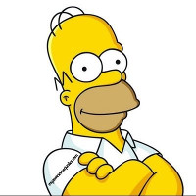
Profil Pengajar
Jabatan Akademik
Latar belakang Pendidikan Pengajar
Hacktiv8
Riwayat Pekerjaan
Bizzy
Contact Pengajar
Ponsel : 081310338777
Email : wahyuendysantoso@gmail.com
DTS 2021

Slide 3
Learning Objective
In this course you will:
A. Understand the basics of programming using the Javascript programming language
B. Understand the algorithm and data structure in the Javascript programming language
DTS 2021
#Jadijagoandigital

Slide 4
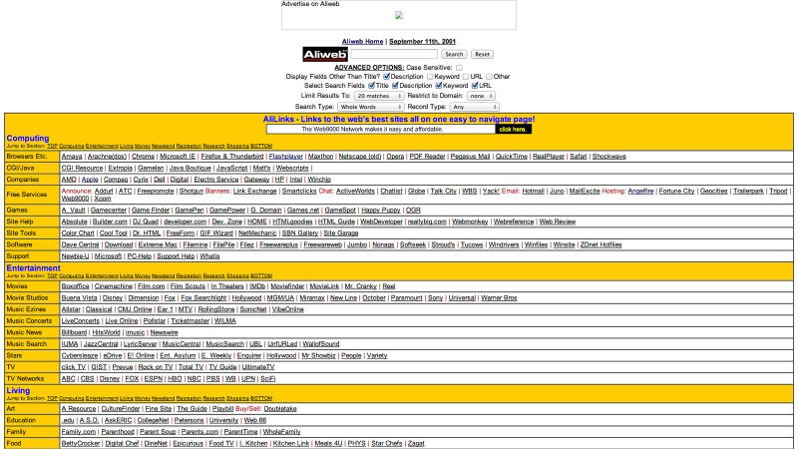
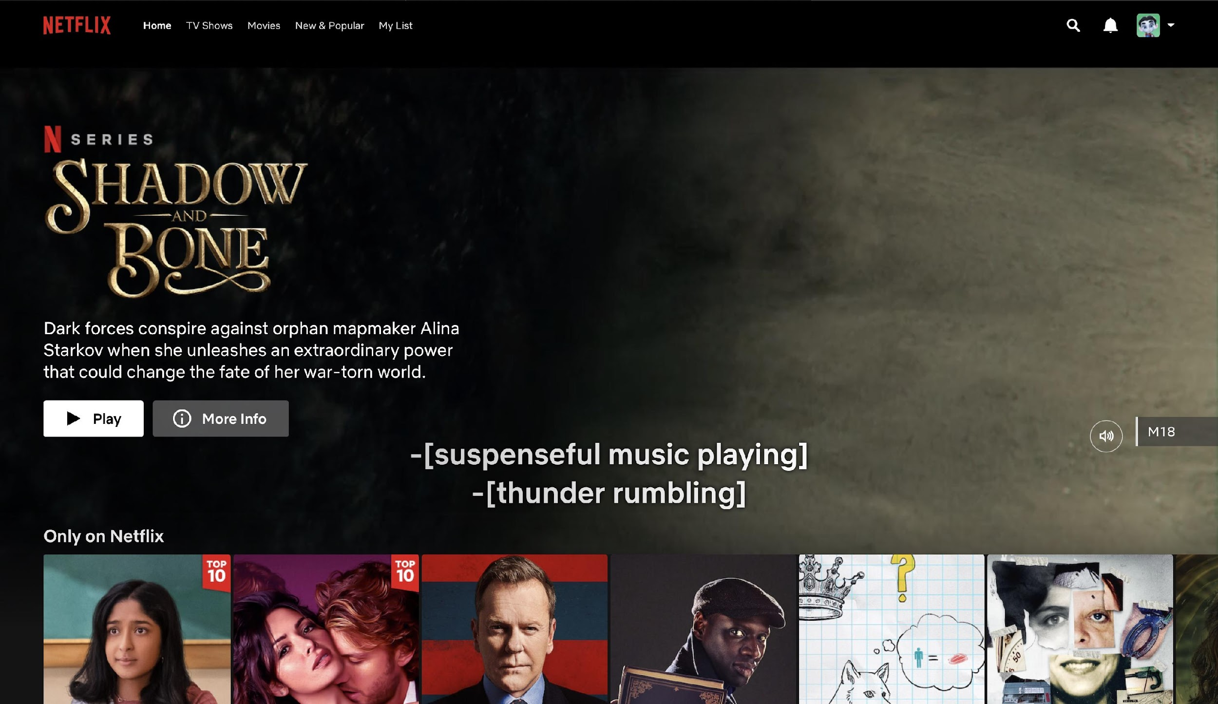
What is Javascript?
After Javascript
Before Javascript
DTS 2021
#Jadijagoandigital

Slide 5
Basics of Javascript
DTS 2021
#Jadijagoandigital

Slide 6
Statement
console.log("Hello");
console.log("World");
DTS 2021
#Jadijagoandigital

Slide 7
Comment
// Semua yang ada di baris ini adalah comment
console.log(“Hello”);
console.log("World"); // Comment ini dimulai setelah statement
/* Semua yang berada di antara ini
merupakan comment yang tidak akan dieksekusi
oleh komputer */
console.log(“Hello World”);
DTS 2021
#Jadijagoandigital

Slide 8
Variable
let message = “Hello”;
console.log(message);
DTS 2021
#Jadijagoandigital

Slide 9
Variable Naming
let userName;
let test123;
DTS 2021
#Jadijagoandigital

Slide 10
Constants
const myMessage = "Hello";
myMessage = "World" // error
DTS 2021
#Jadijagoandigital

Slide 11
Data Type
let nameFieldChecked = true;
let num = 123;
num = 12.345;
let str = "Hello";
let str2 = 'Single quote string’;
let isGreater = 4 > 1;
console.log(isGreater); // true
number
string
boolean
let age;
console.log(age); // undefined
let age = null;
null
undefined
DTS 2021
#Jadijagoandigital

Slide 12
Comparison
console.log( 2 > 1 ); // true
console.log( 2 == 1 ); // false
console.log( 2 != 1 ); // true
console.log('Z' > 'A'); // true
console.log('Glow' > 'Glee') // true
console.log('Bee' > 'Be') //true
console.log('2' > 1); // true, string '2' menjadi number 2
console.log('01' == 1); // true, string '01' menjadi number 1
console.log(true == 1); // true
console.log(false == 0); // true
DTS 2021
#Jadijagoandigital

Slide 13
Strict Equality
console.log(0 == false); // true
console.log('' == false); // true
console.log(0 === false); // false, karena tipe datanya berbeda
DTS 2021
#Jadijagoandigital

Slide 14
Conditional Statement
DTS 2021
#Jadijagoandigital

Slide 15
If Statement
if (year == 2015) {
console.log("You are right!");
console.log("It is the year 2015");
}
DTS 2021
#Jadijagoandigital

Slide 16
Else Statement
let year = 2015;
if (year == 2015) {
console.log("You are right!");
} else {
console.log("You are so wrong"); // akan dieksekusi ketika variable year != 2015
}
DTS 2021
#Jadijagoandigital

Slide 17
Else If Statement
if (year < 2015) {
console.log("Too early"); // akan dieksekusi ketika year < 2015
} else if (year > 2015) {
console.log("Too late"); // akan dieksekusi ketika year > 2015
} else {
console.log("Exactly!"); // akan dieksekusi ketika year tidak memenuhi 2 kondisi diatas
}
DTS 2021
#Jadijagoandigital

Slide 18
Conditional Operator
let age = 19;
let accessAllowed = (age > 18) ? true : false;
console.log(accessAllowed); // true
DTS 2021
#Jadijagoandigital

Slide 19
Logical Operator
DTS 2021
#Jadijagoandigital

Slide 20
OR
console.log(true || true); // true
console.log(true || false); // true
console.log(false || true); // true
console.log(false || false); // false
let hour = 9;
if (hour < 10 || hour > 18) {
console.log("The office is closed");
}
DTS 2021
#Jadijagoandigital

Slide 21
AND
console.log(true && true); // true
console.log(true && false); // false
console.log(false && true); // false
console.log(false && false); // false
let hour = 12;
let isWeekday = true;
if (hour > 10 && hour < 18 && isWeekday) {
console.log("The office is open");
}
DTS 2021
#Jadijagoandigital

Slide 22
NOT
let hour = 12;
let isMidday = hour == 12;
console.log(isMidday); //true
console.log(!isMidday); //false
DTS 2021
#Jadijagoandigital

Slide 23
Loop
DTS 2021
#Jadijagoandigital

Slide 24
While
let i = 0;
while (i < 3) { // akan menampilkan 0, kemudian 1, dan 2
console.log(i);
i++;
}
DTS 2021
#Jadijagoandigital

Slide 25
Do While
let i = 0;
do {
console.log(i);
i++;
} while (i < 3);
DTS 2021
#Jadijagoandigital

Slide 26
For
begin
step
for (let i = 0; i < 3; i++) {
console.log(i);
}
condition
DTS 2021
#Jadijagoandigital

Slide 27
Switch Statement
let a = 2 + 2;
switch (a) {
case 3:
console.log("Too small");
break;
case 4:
console.log("Exactly");
break;
case 5:
console.log("Too big");
break;
default:
console.log("I don't know such values");
}
DTS 2021
#Jadijagoandigital

Slide 28
Function
DTS 2021
#Jadijagoandigital

Slide 29
Function Declaration
function showMessage() {
console.log("Hello everyone!");
}
showMessage();
showMessage();
DTS 2021
#Jadijagoandigital

Slide 30
Local Variable
function showMessage() {
let message = "Hello, I'm Javascript!"; // variable lokal
console.log(message);
}
showMessage(); // Hello, I'm Javascript!
console.log(message); // Error! Variable hanya tersedia di dalam function
DTS 2021
#Jadijagoandigital

Slide 31
Outside Variable
let userName = "John";
function showMessage() {
let message = "Hello, " + userName;
console.log(message);
}
showMessage(); // Hello, John
DTS 2021
#Jadijagoandigital

Slide 32
Parameter
function showMessage(from, text) { // parameter: from, text
console.log(from + ': ' + text);
}
showMessage("Mike", "Hello!"); // Mike: Hello!
showMessage("Mike", "What's up?"); // Mike: What's up?
DTS 2021
#Jadijagoandigital

Slide 33
Default Parameter
function showMessage(from, text = "no text") {
console.log(from + ': ' + text);
}
showMessage("Ann"); // Ann: no text
DTS 2021
#Jadijagoandigital

Slide 34
Return Value
function sum(a, b) {
return a + b;
}
let result = sum(1,2);
console.log(result); // 3
DTS 2021
#Jadijagoandigital

Slide 35
Referensi
Intro to Javascript: https://javascript.info
DTS 2021
#Jadijagoandigital

Slide 36
Tools / Lab Online
Visual Studio Code (https://code.visualstudio.com)
Node JS (https://nodejs.org/en/)
DTS 2021
#Jadijagoandigital

Slide 37

Terima Kasih
#Jadijagoandigital

